Slide 1
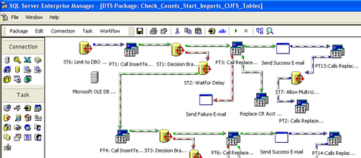


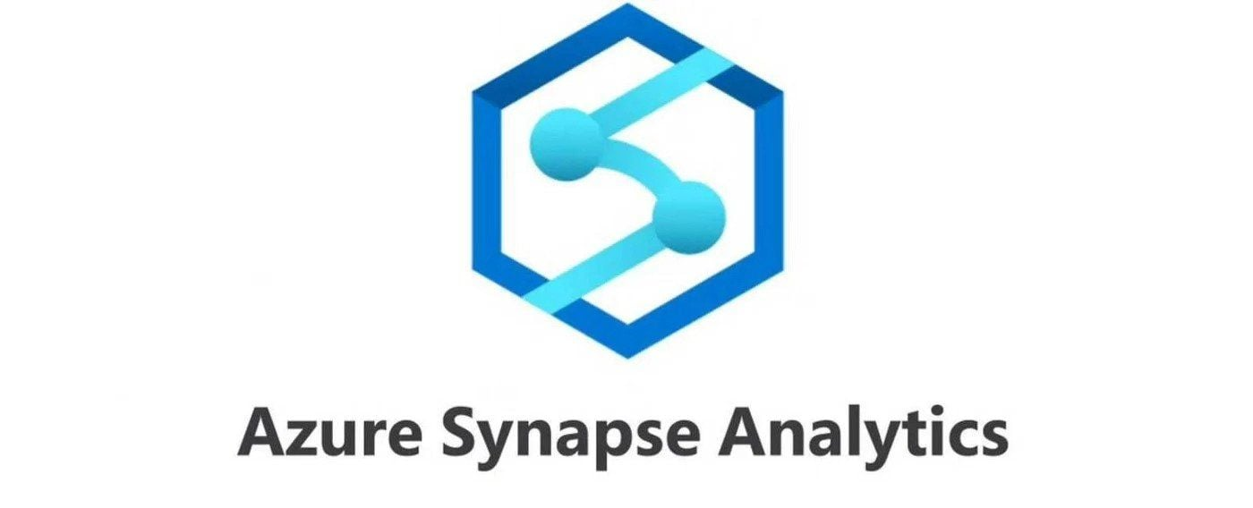

SSIS to Synapse to Fabric A Data Architects Case Study
Bob Duffy

Slide 2

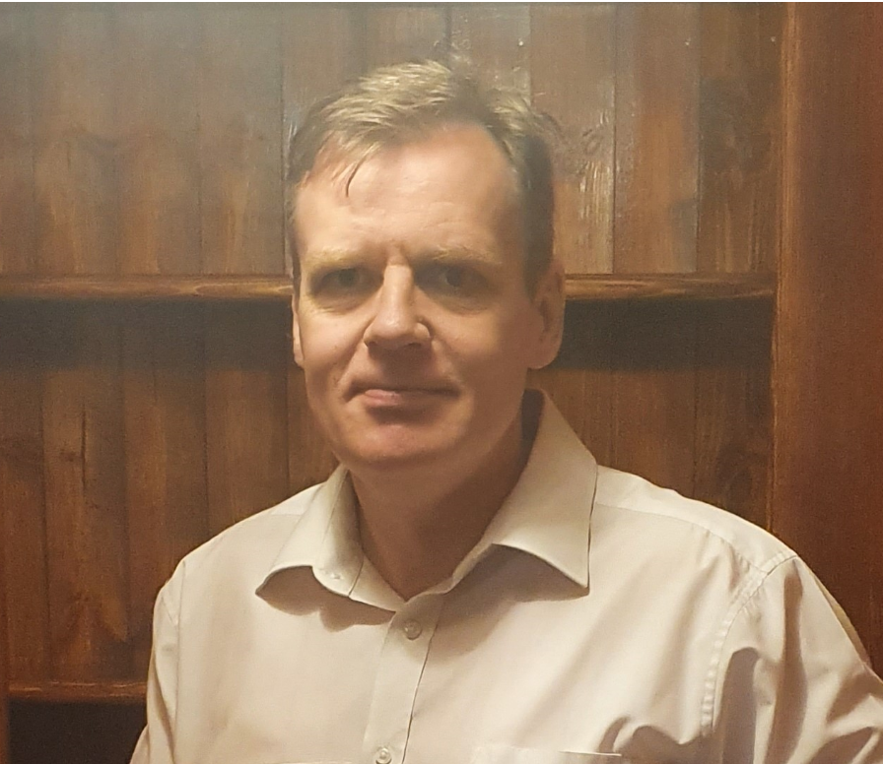

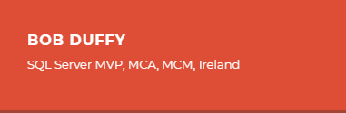
Bob Duffy
32 years in database sector, 250+ projects
Power BI FTRSA
SQL Server MCA, MCM, MVP
SSAS Maestro
Senior Data Platform Consultant with Microsoft 2005-2008
Database Architect at Prodata SQL Centre of Excellence
http://blogs.prodata.ie/author/bob.aspx
bob@prodata.ie

Slide 3

Agenda
The Road to the Declarative SSIS
Migrating to Synapse/ADF
Migrating to Fabric
Unit Testing
Lesson learned /Fabric Wish List
https://sqlb.it/?12640

Slide 4
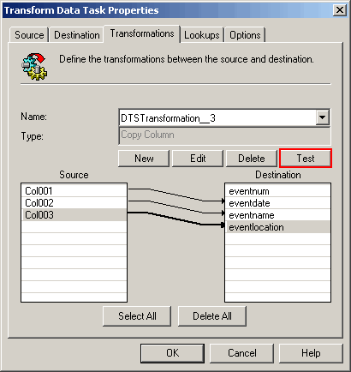
SQL 7.0 and DTSX 1998
*SQL is Dead !
Orchestraion and Control Flow
SQL Shapes, External Call and Pipelines
Everything Imperitive
The first “Pipeline” within SQL Stack#
** Do everything in the Pipeline !

Slide 5




SSIS/SQL DW Architecture 2006
2. Extract
3. Transform & Load
4. Refresh
DW Star Schema
Enterprise Cube (MOLAP)
IBMMQ
T &L 1
Stage File 1
T &L 2
Stage File 2
T &L 3
Stage File 3
T &L 4
Stage File 4
T &L 5
T &L 5
*SQL is Dead !
** Do everything in the Dataflow !

Slide 6
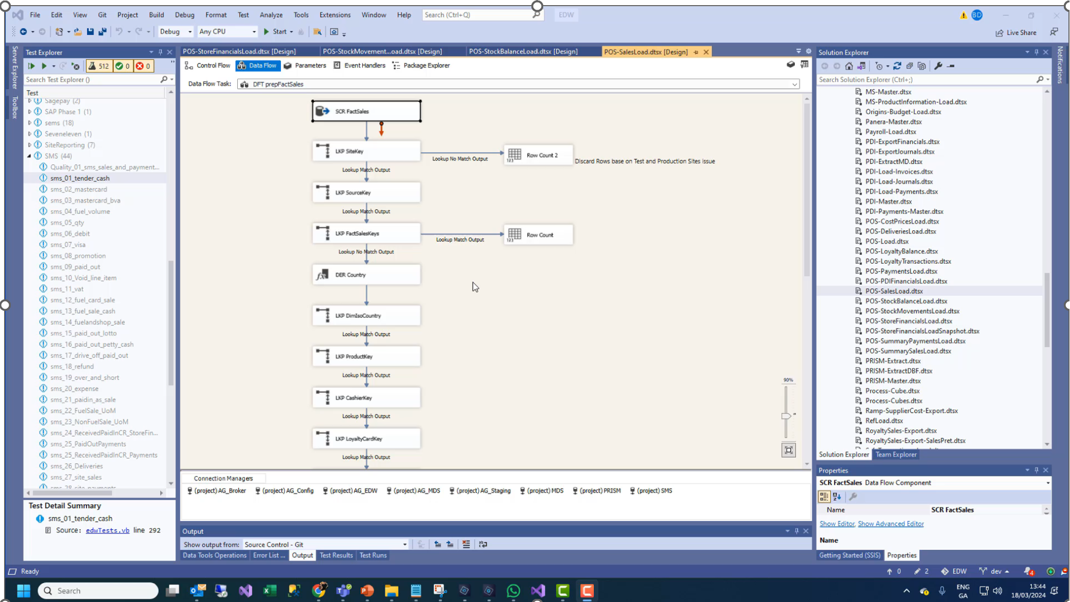
A “well designed” SSIS Data Flow (2 mins)

Slide 7
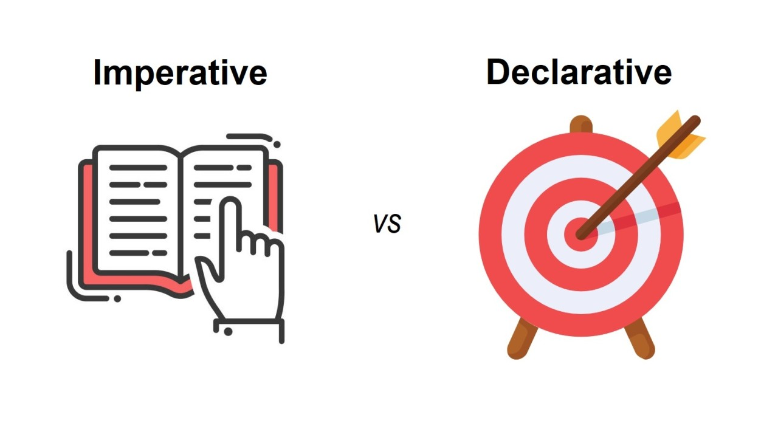

SSIS Paradigm Shift
SSIS Framework
Enterprise Features
Logging
Lineage
Error Handling
Controller / Worker
Orchestration
DTSX Packages
SQL Procedures
Polybase (or BULK IMPORT)
1. Ingest
2. Extract
3. Transform & Load
4. Refresh
Landing
Staging
Star Schema
Finance
Sales
Scorecards

Slide 8
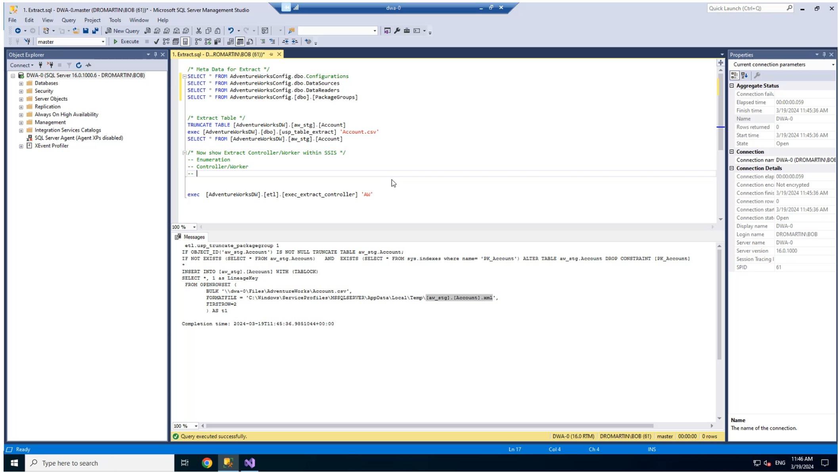
Demo of DWA in SSIS (5 mins)

Slide 9
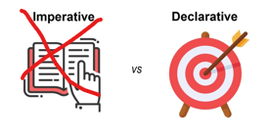

ADF/Synapse 2019
SSIS Framework
Synapse Framework
Enterprise Features
Enterprise Features
Logging
Lineage
Error Handling
Logging
Lineage
Error Handling
Controller / Worker
Orchestration
Orchestration
Pipelines
DTSX Packages
Azure Functions
SQL Procedures
SQL Procedures
COPY INTO
Polybase (or BULK IMPORT)
1. Ingest
2. Extract
3. Transform & Load
4. Refresh
Landing Data Lake
Staging
Star Schema
Finance
Pipelines
Pipelines
SQL Procedures
Sales
Azure Functions
COPY INTO
Scorecards
Azure Functions
*SQL is Dead !
** Do everything in the Pipeline/Data Flow
https://prodata.ie/2021/10/03/a-dw-automation-maturity-model-2-3

Slide 10
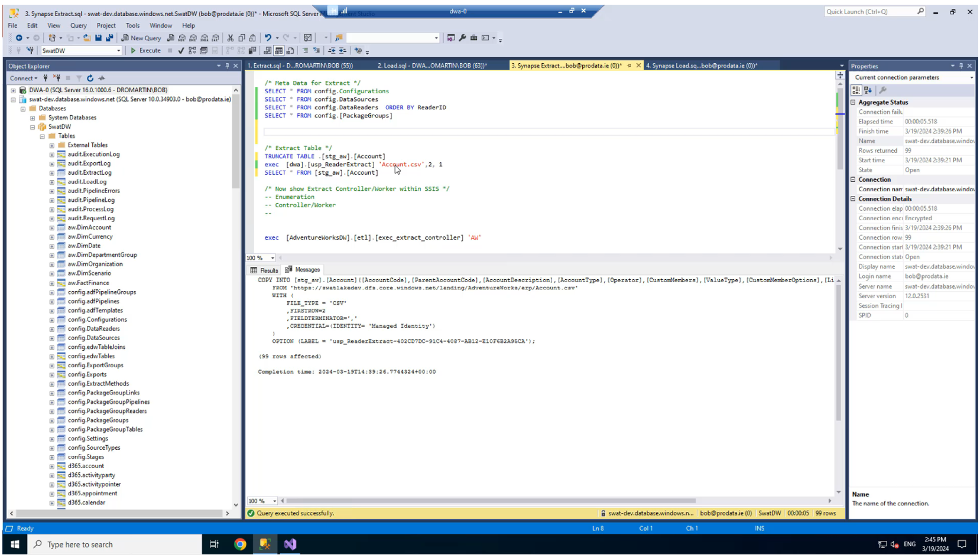
Synapse DWA Demo

Slide 11
Issues with SSIS/SqlDbEngine => Synapse
Latency and Performance
ADF has massive Queue Time compared to SSIS
ADF For Loops to slow for scale
SqlPools not suited for logging and Metadata
Table Structure and Distributrions
Lower TSQL Programmability.
Temp Tables, cursors, sproc parameters, etc
Tuning and Instrumentation
Much harder to tune and different logs

Slide 12
Fabric DWA Framework
Fabric 2023
*TSQL is Dead !
Enterprise Features
** Do everything in the Data Flow/Notebooks
Logging
Lineage
Error Handling
Orchestration
Controller / Worker
Pipelines
SQL Procedures
Notebooks
SQL Views
Dataflows
Azure Functions
1. Ingest
2. Extract
3. Transform & Load
4. Refresh
Raw Files
Staging
Lakehouse
Finance
OR
Sales
Warehouse
Scorecards
Bronze
Silver
Gold/Platinum

Slide 13
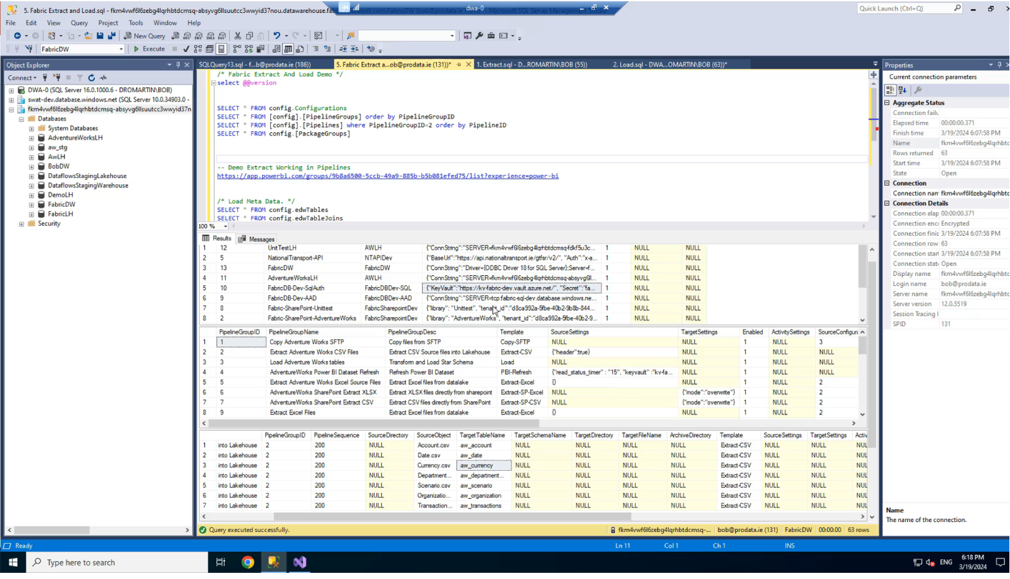
Fabric Demo

Slide 14
Fabric Wish List
SQLDB Integration
Dynamic Pipeline Execution
OPDG (For Pipelines and Notebooks)
Identity Data Type
Managed Identity
Faster Spark spin Up. Even persistant sessions
Custom DNS for connection strings (eg dev=>tst=>prd)
Global Parameters in Notebooks and Pipelines
Native Pyspark connections to DW
https://prodata.ie/2024/03/20/fabric-wish-list-for-dwa/

Slide 15
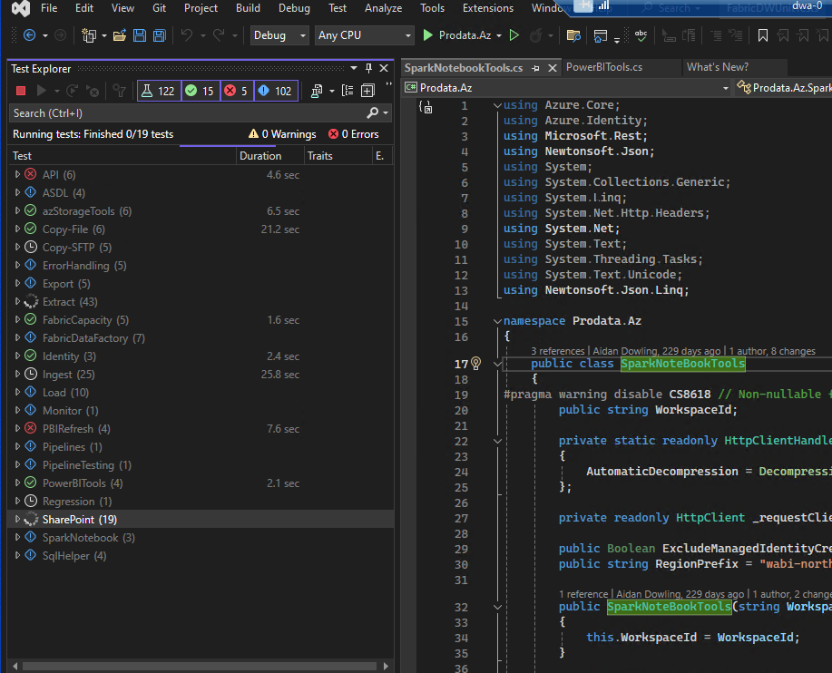
Unit Testing with Visual Studio
https://github.com/ProdataSQL/Fabric

Slide 16
What Changed ?
Feature | SSIS/SQL | ADF/Synapse | Fabric
Data Lake | SMB File Shares | ASDL | One Lake
File Enumeration | VB.Net | ADF Metadata | Library Templates Pipelines/Notebooks
CSV Extract | OPENROWSET | COPY INTO
Excel Extract | OPENROWSET | Pipeline Library
Custom Extract | SSIS Data Flow + Dot.Net | Pipeline Library
Orchestration | Dynamic & Static | Dynamic & Static | Dynamic & Static
Load | Dynamic TSQL | Dynamic TSQL | Dynamic SQL
Meta Data Marshalling | Unpacked into Table | Using Pointers | Using Pointers
Ingest | PowerShell | Pipeline Library + Azure Functions | Pipelines/Notebooks

Slide 17

Thank You
https://prodata.ie/author/bob
https://github.com/ProdataSQL/Fabric
https://prodata.ie/fabric-dwa/
https://sqlb.it/?12640

Slide 18














Slide 21
Point 1
Point 2
Point 3

